Slide 1

Predicting the Next Blockbuster
Box Office
Smash
Victoria Anorve, Joel Pepera, Benya Piyathamsoontorn, Radha Yadavilli, & Dan Zhou

Slide 2
Problem
[description of problem & hypothesis here]

Slide 3
Data Ingestion & Wrangling

Slide 4



Sources
Domestic Gross Box Office
Sales (target)
Release Date
Production Budget
Movie Rating
Studio
Movie Runtime
Genres
Keyword Descriptions
Directors
Writers
Composers
Actors/Actress

Slide 5
Feature Engineering
Release Date → Release Year & Release Week
Production Budget → Scaled to [0, 1] Movie Rating
Movie Rating → One-Hot Encoded
Studio → One-Hot Encoded (Top 6 Only)
Movie Runtime → Scaled to [0, 1]
Genres → One-Hot Encoded (Top 15 Only)
Keyword Descriptions → One-Hot Encoded (Most Frequent)
Directors → One-Hot Encoded (Top 14 Only)
Writers → Dropped
Composers → Dropped
Actors/Actress → One-Hot Encoded (Top 41 Only)

Slide 6
Exploratory Analysis

Slide 7
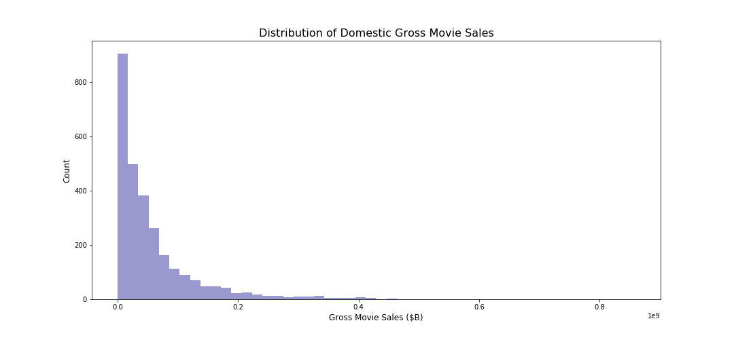
Target Variable – Gross Domestic Sales

Slide 8
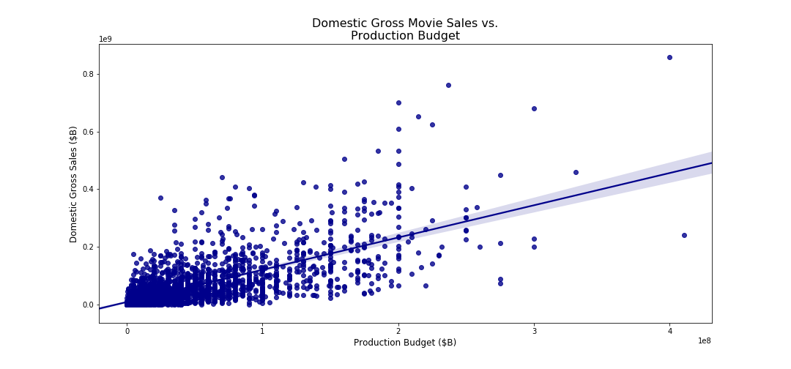
Sales vs. Budget

Slide 9
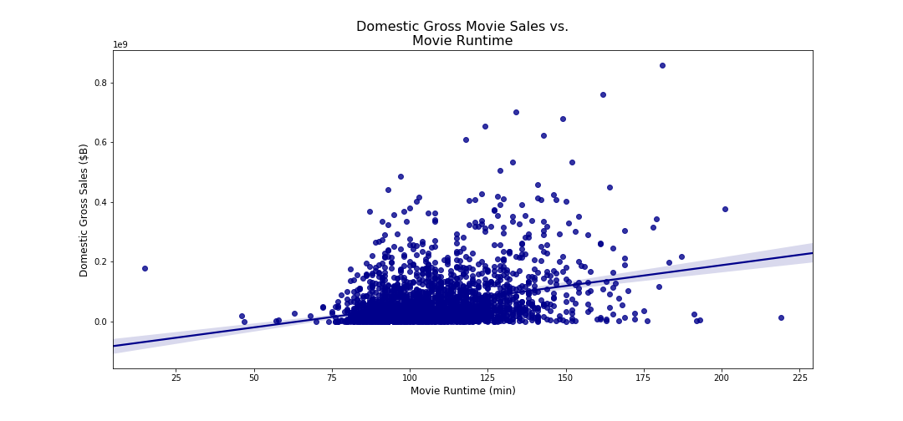
Sales vs. Runtime

Slide 10
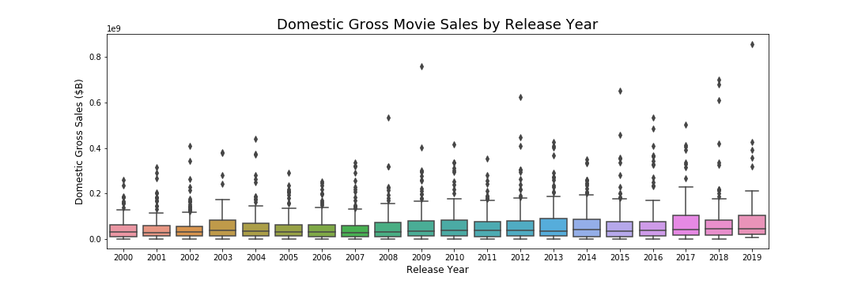
Sales by Year

Slide 11
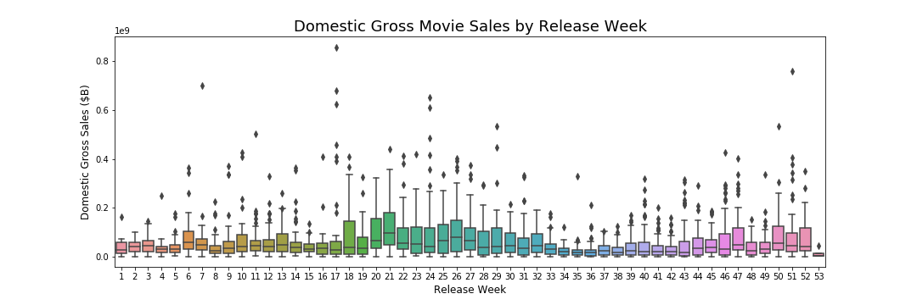
Sales by Week of Release

Slide 12
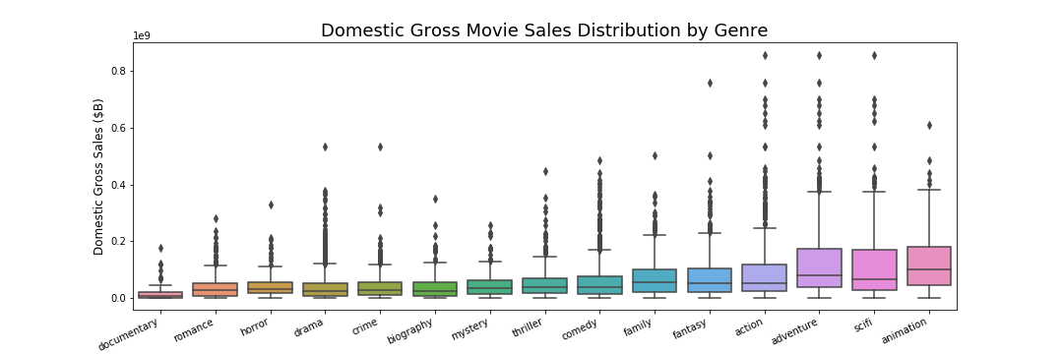
Sales by Genre

Slide 13
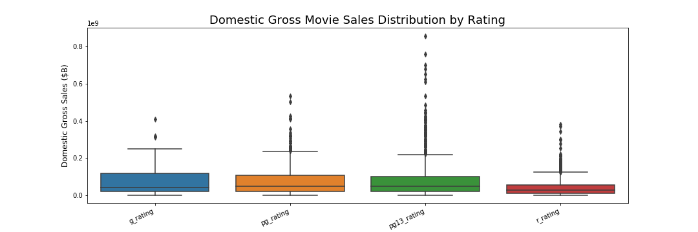
Sales by Rating

Slide 14
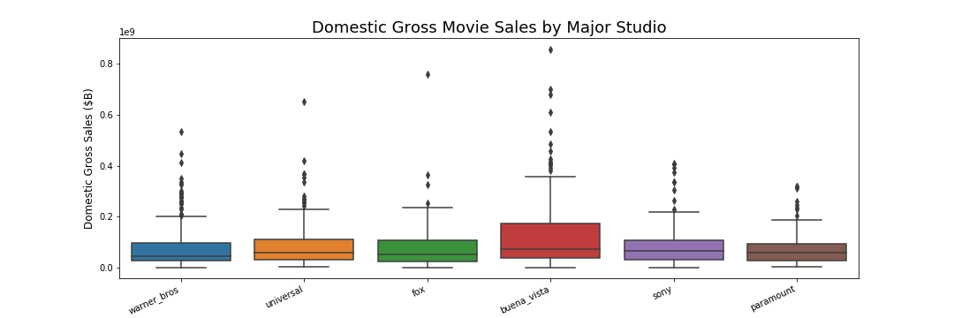
Sales by Studio

Slide 15
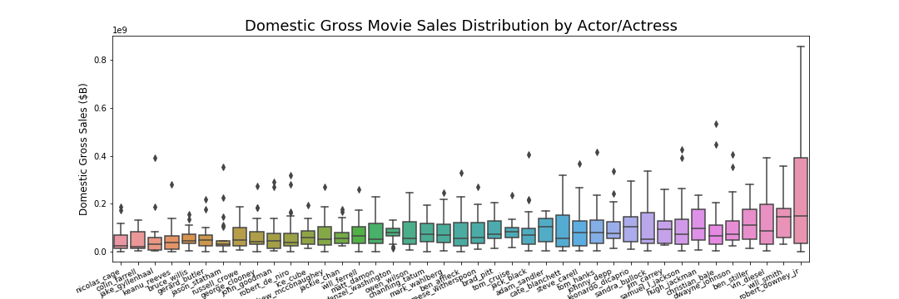
Sales by Actor/Actress

Slide 16
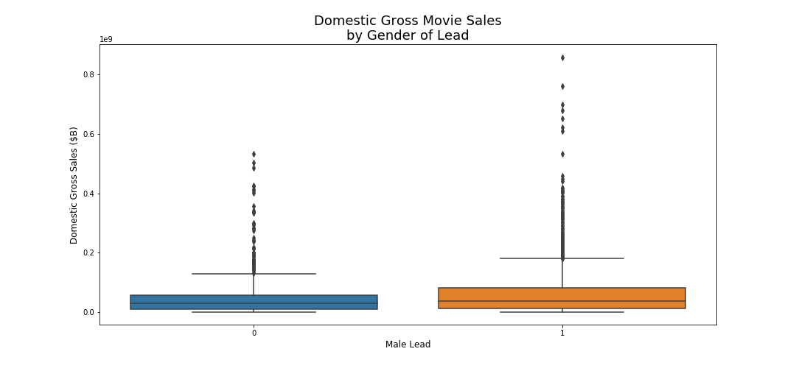
Sales by Gender of Lead

Slide 17
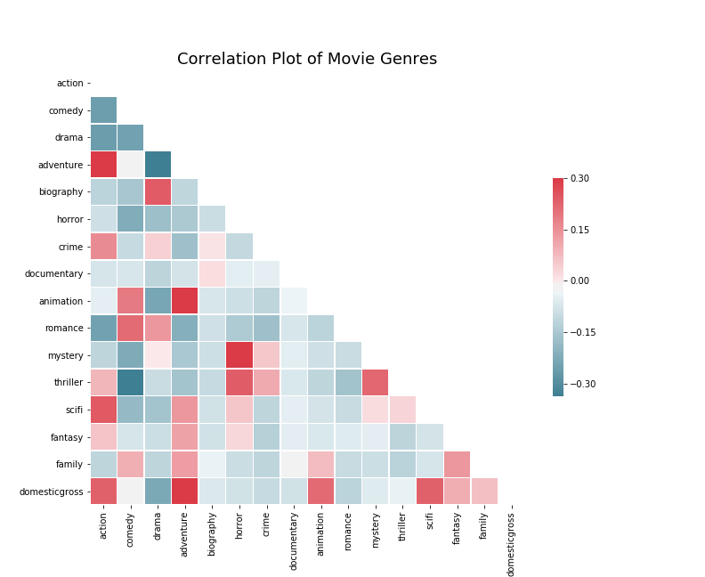
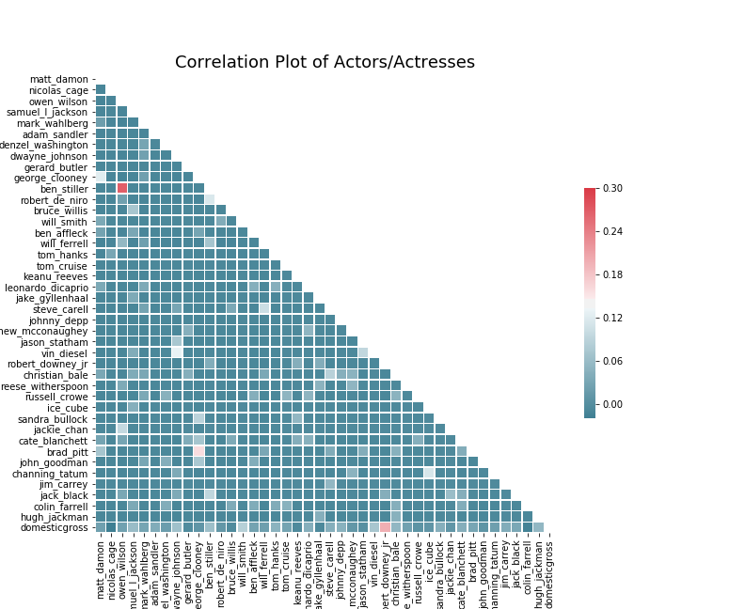
Genre & Actor Correlation
Note: Attempts to reduce genre dimensionality (PCA, Kmeans, AgglomerativeClustering, DBScan) failed to improve model performance

Slide 18
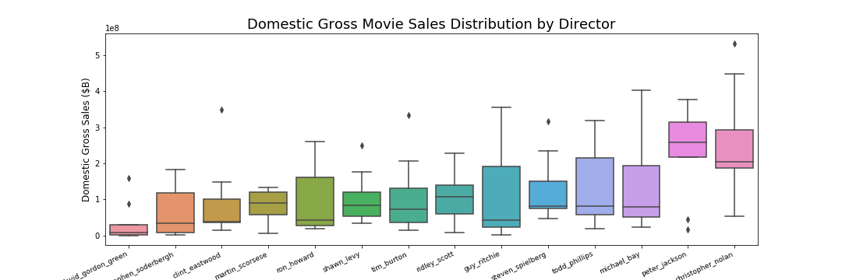
Sales by Director

Slide 19
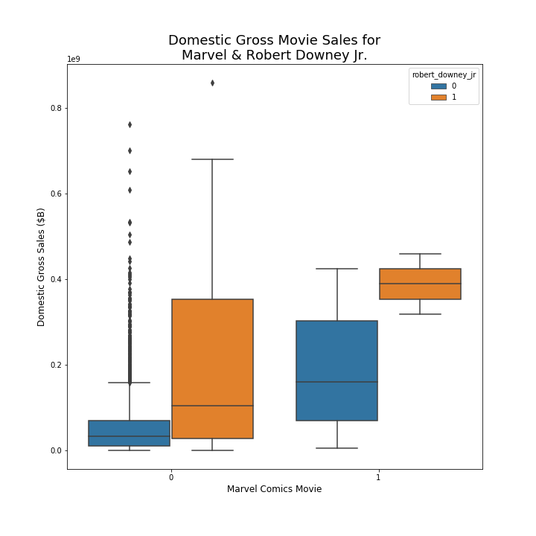
Marvel Comics or Robert Downey, Jr?

Slide 20
Trends over Time

Slide 21
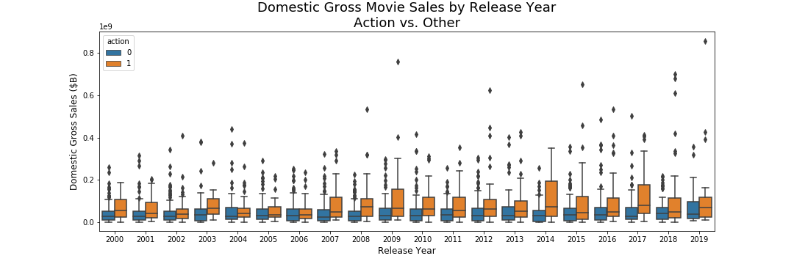
Strong Decade for Action

Slide 22
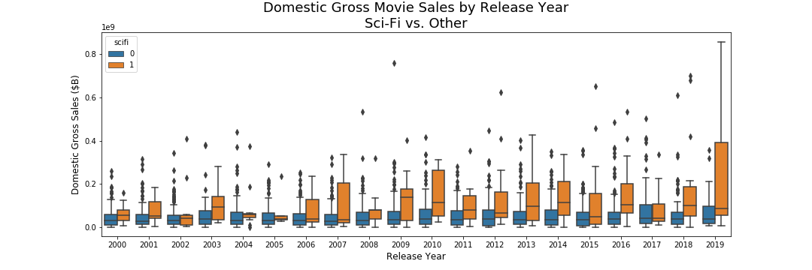
…and Sci-Fi

Slide 23
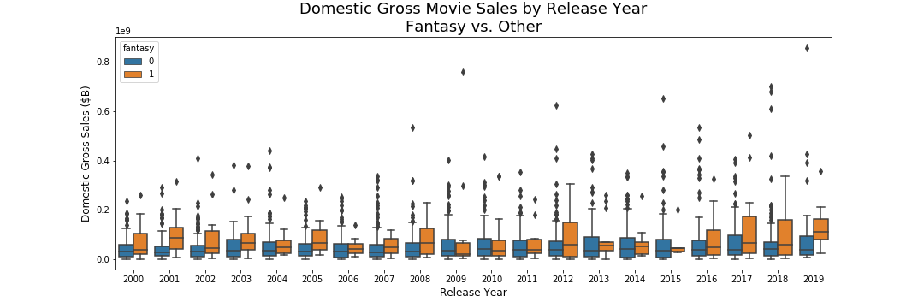
Fantasy Emerging?

Slide 24
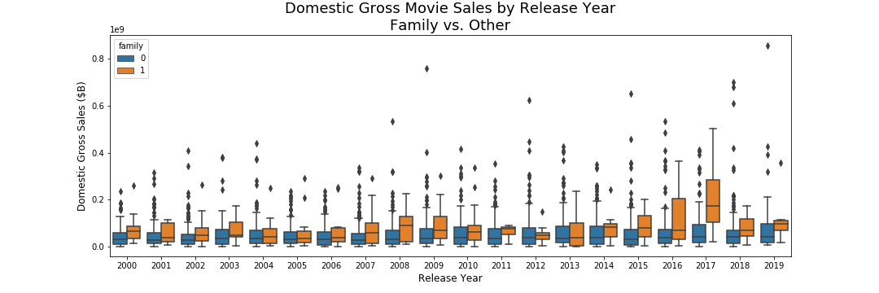
A Couple Good Years for Family Films

Slide 25
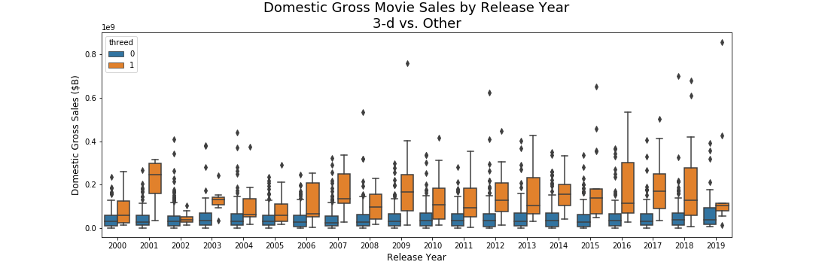
3-D Consistently Strong

Slide 26
Model Training, Selection, & Analysis

Slide 27


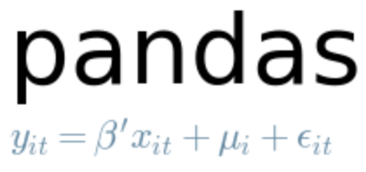
Pipeline Construction
SimpleImputer (median)
Numeric
MinMaxScaler
Column Transformer
Regressor
Categorical
SimpleImputer (0)

Slide 28
Model Selection
Initial Experimentation
Hyperparameter Tuning
Selection & Final Tuning
Gradient Boosting Regressor
Multi-Layer Perceptron
Gradient Boosting Regressor
Nearest Neighbors Regessor
Bayesian Ridge
Elastic Net Regression
Gradient Boosting Regressor
Linear Regression
Lasso Lars
Elastic Net Regression
Random Forest Regressor
Lasso Lars
Random Forest Regressor

Slide 29
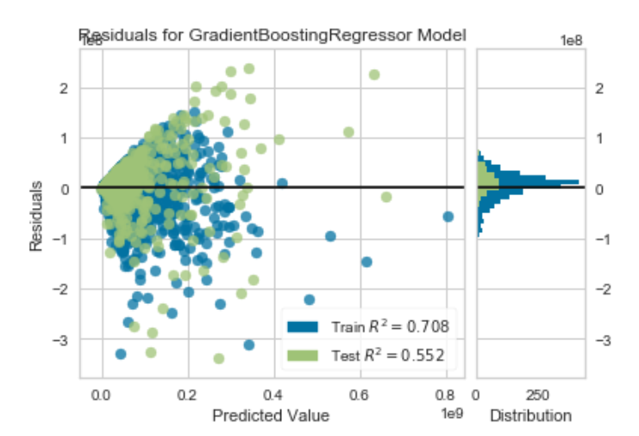
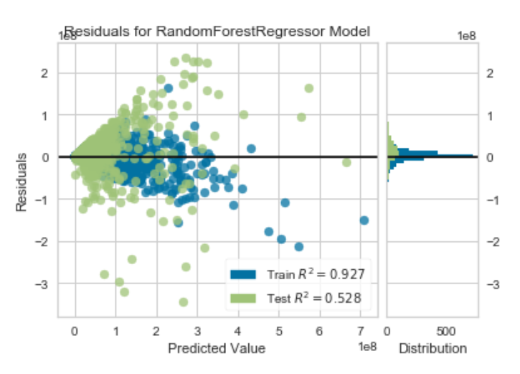
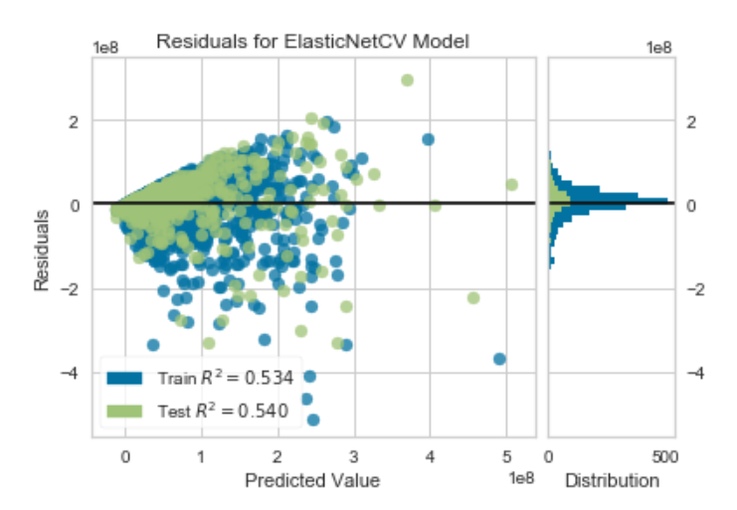
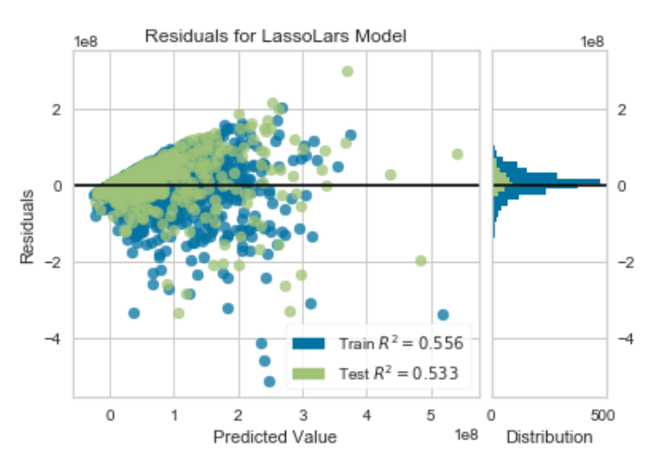
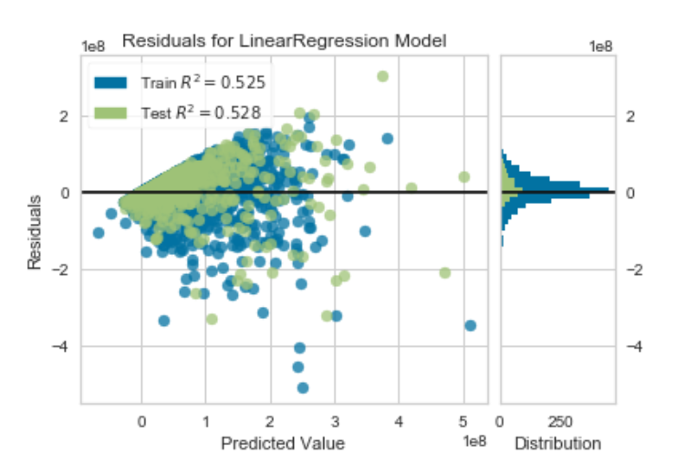
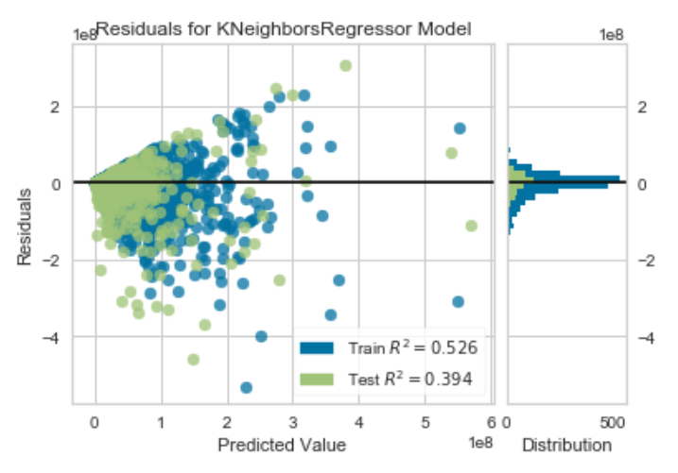
Performance Comparison

Slide 30
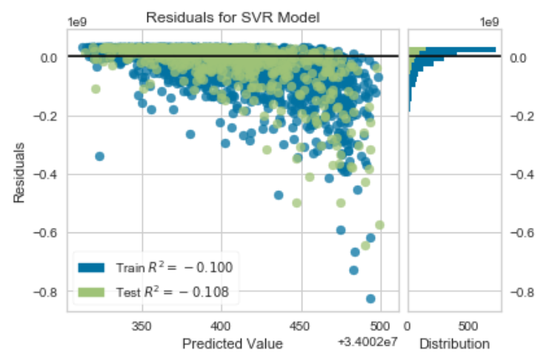
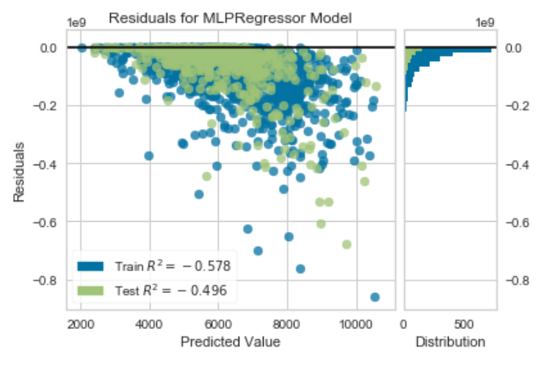
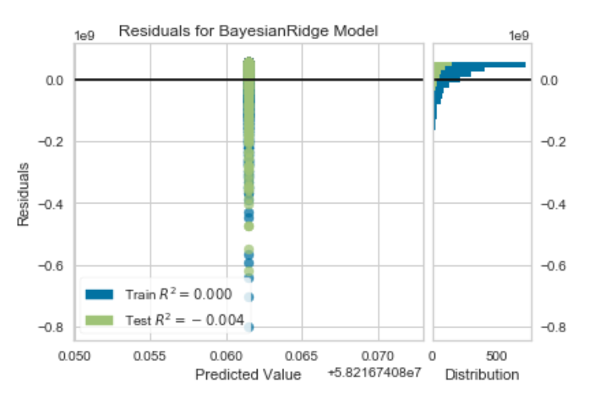
Performance Comparison

Slide 31
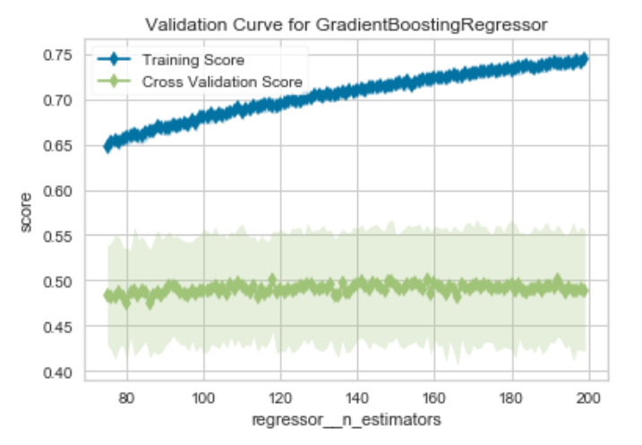
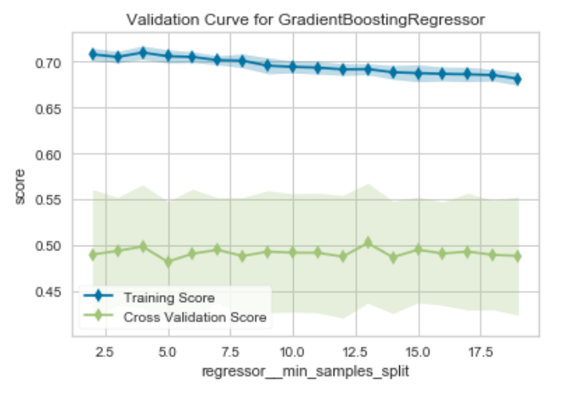
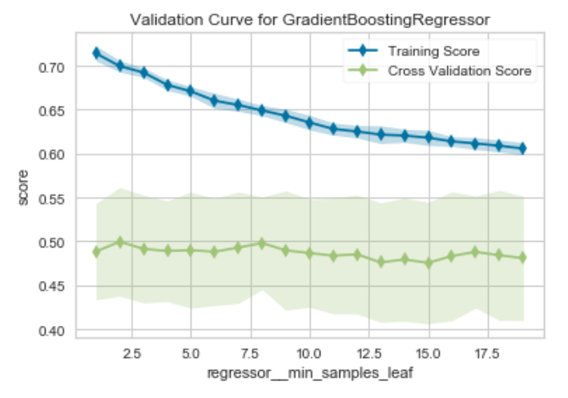
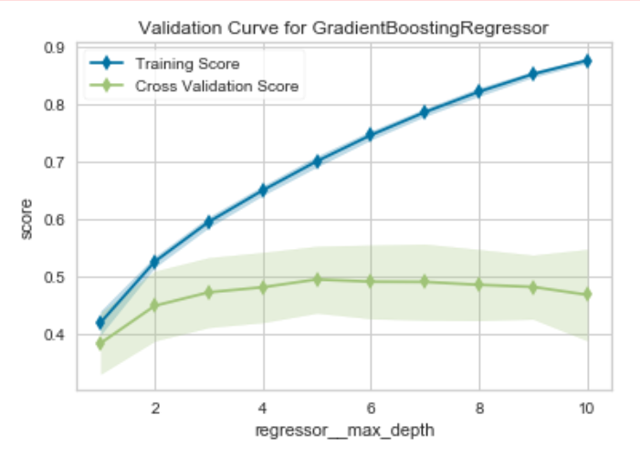
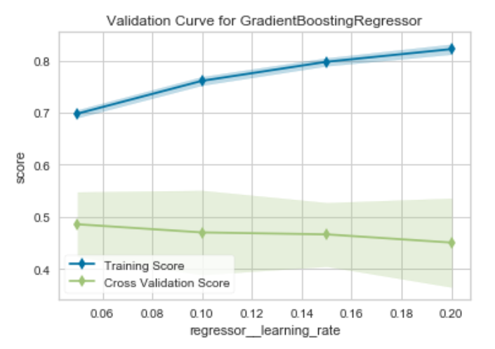
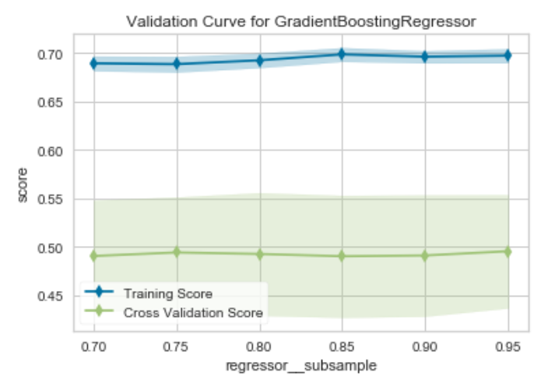
Hyperparameter Tuning - GBM

Slide 32
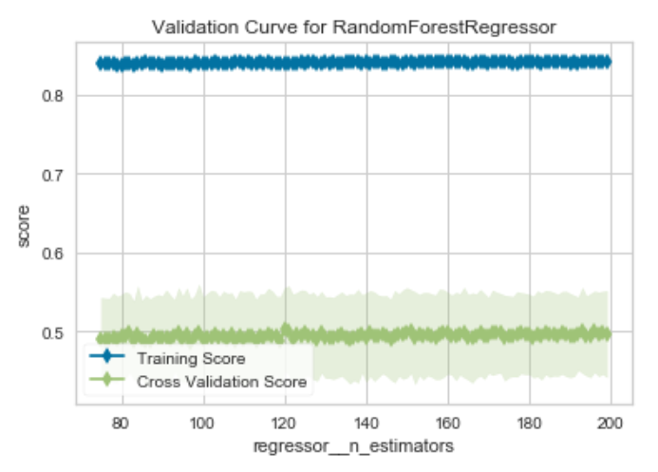
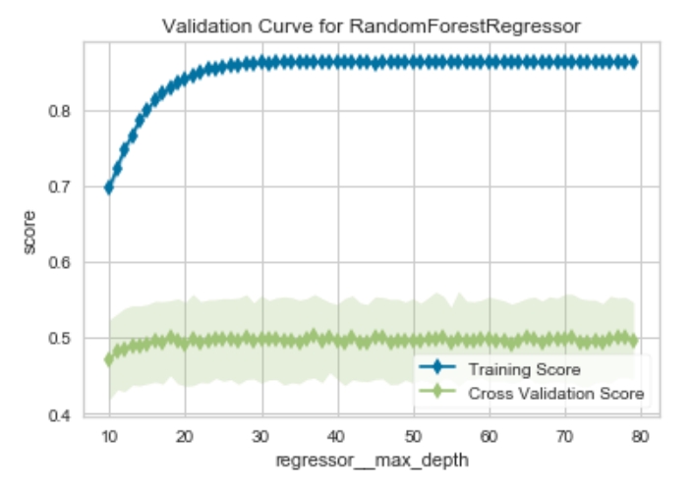
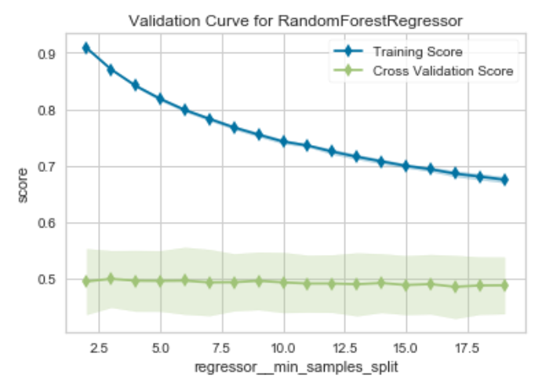
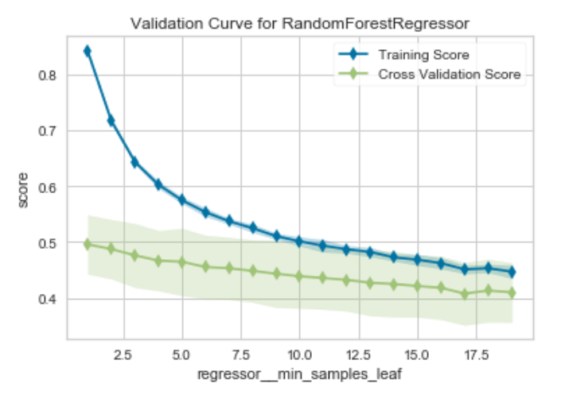
Hyperparameter Tuning – Random Forest

Slide 33
Final Models - RandomizedSearchCV
Model
R^2
GradientBoostingRegressor(alpha=0.9, ccp_alpha=0.0, criterion='friedman_mse', init=None, learning_rate=0.05, loss='ls', max_depth=5, max_features='sqrt', max_leaf_nodes=None, min_impurity_decrease=0.0, min_impurity_split=None, min_samples_leaf=2, min_samples_split=8, min_weight_fraction_leaf=0.0, n_estimators=125, n_iter_no_change=None, presort='deprecated', random_state=None, subsample=1, tol=0.0001, validation_fraction=0.1, verbose=0, warm_start=False)
.586
RandomForestRegressor(bootstrap=True, ccp_alpha=0.0, criterion='mse', max_depth=20, max_features='sqrt', max_leaf_nodes=None, max_samples=None, min_impurity_decrease=0.0, min_impurity_split=None, min_samples_leaf=1, min_samples_split=4, min_weight_fraction_leaf=0.0, n_estimators=150, n_jobs=None, oob_score=False, random_state=None, verbose=0, warm_start=False)
.565

Slide 34
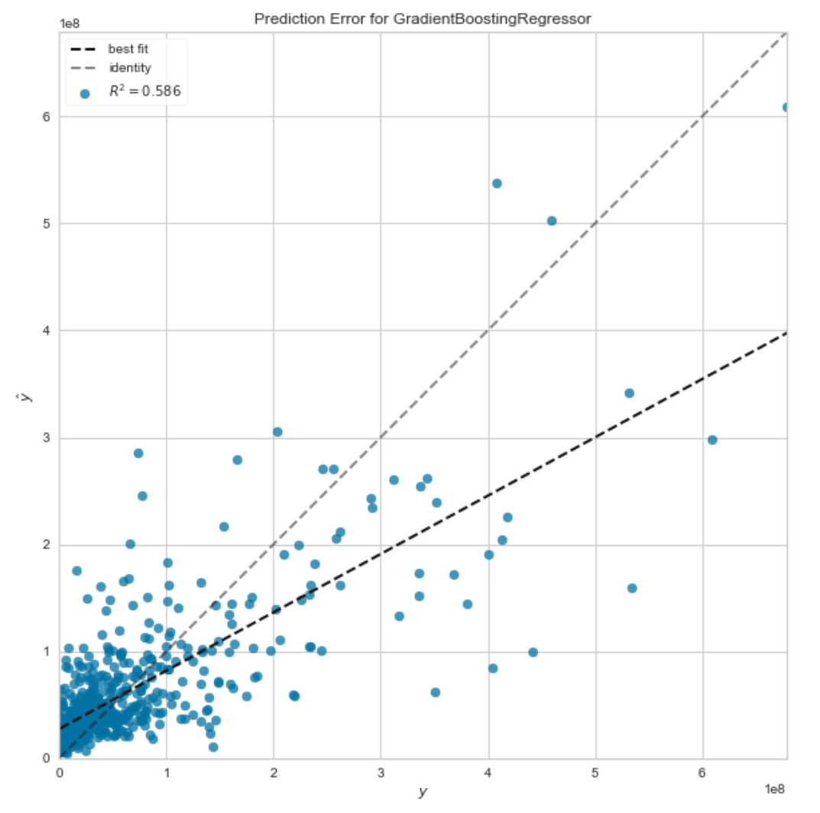
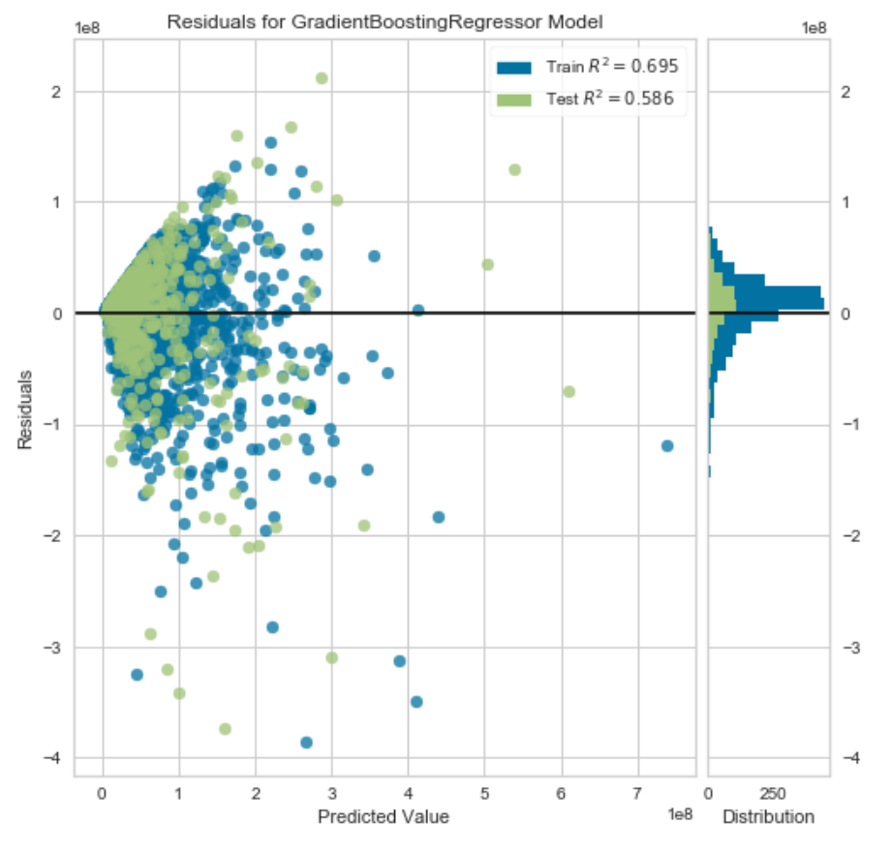
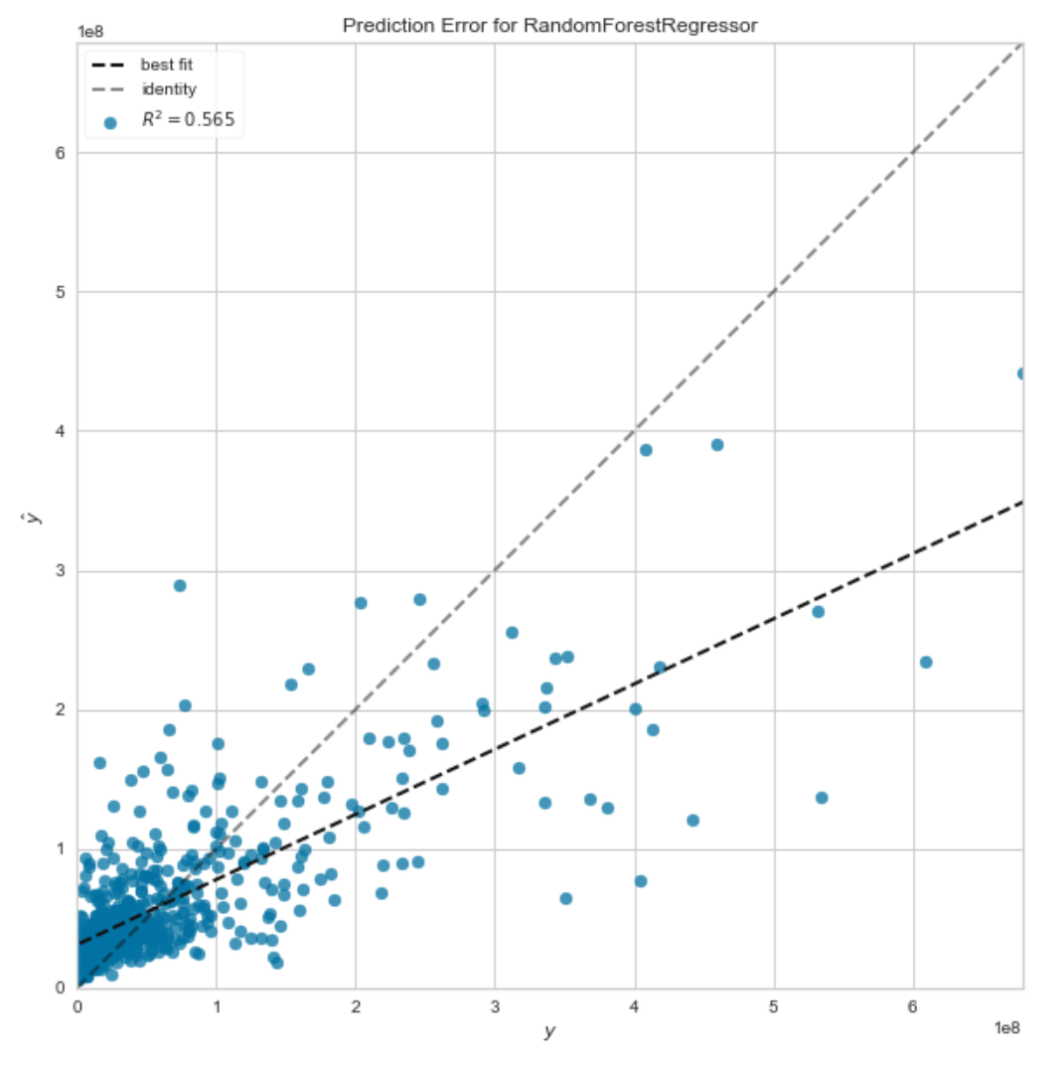
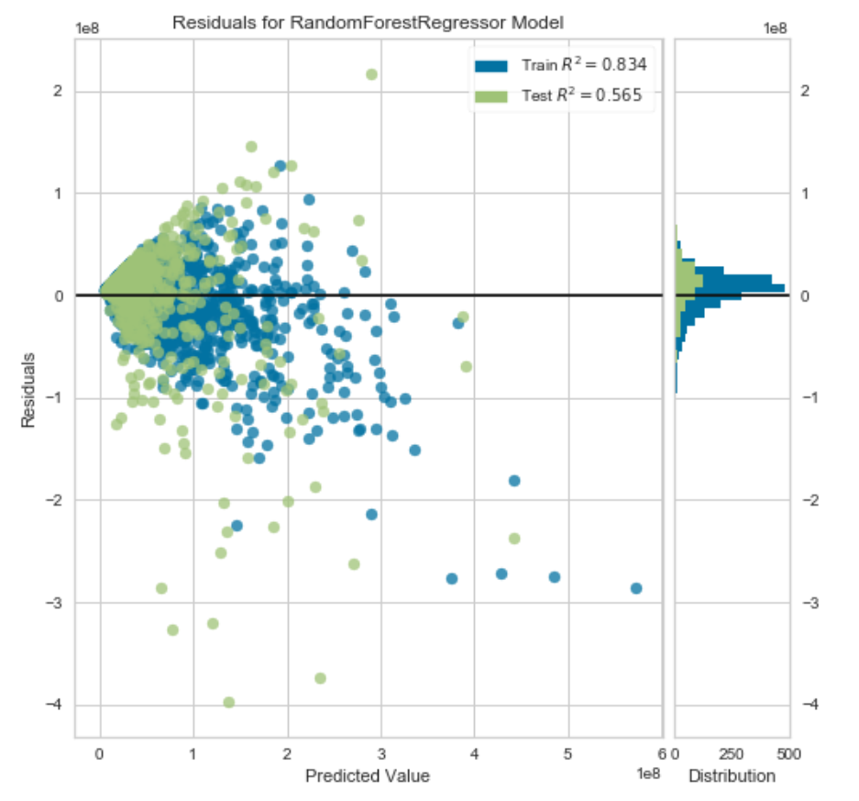
GradientBoostingRegressor
RandomForestRegressor
Final Models – Performance Comparison

Slide 35
Model Analysis - GBM

Slide 36
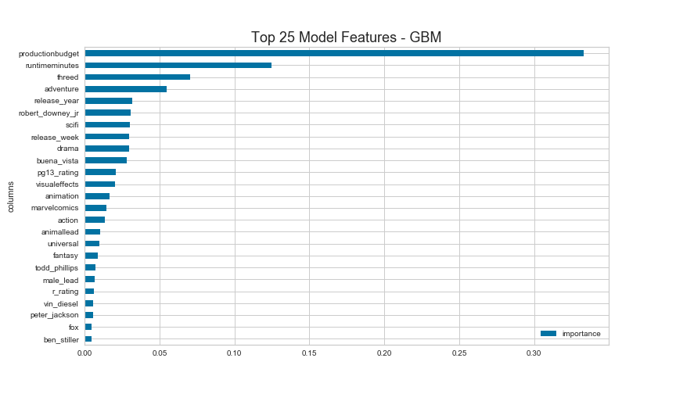
Feature Importance

Slide 37
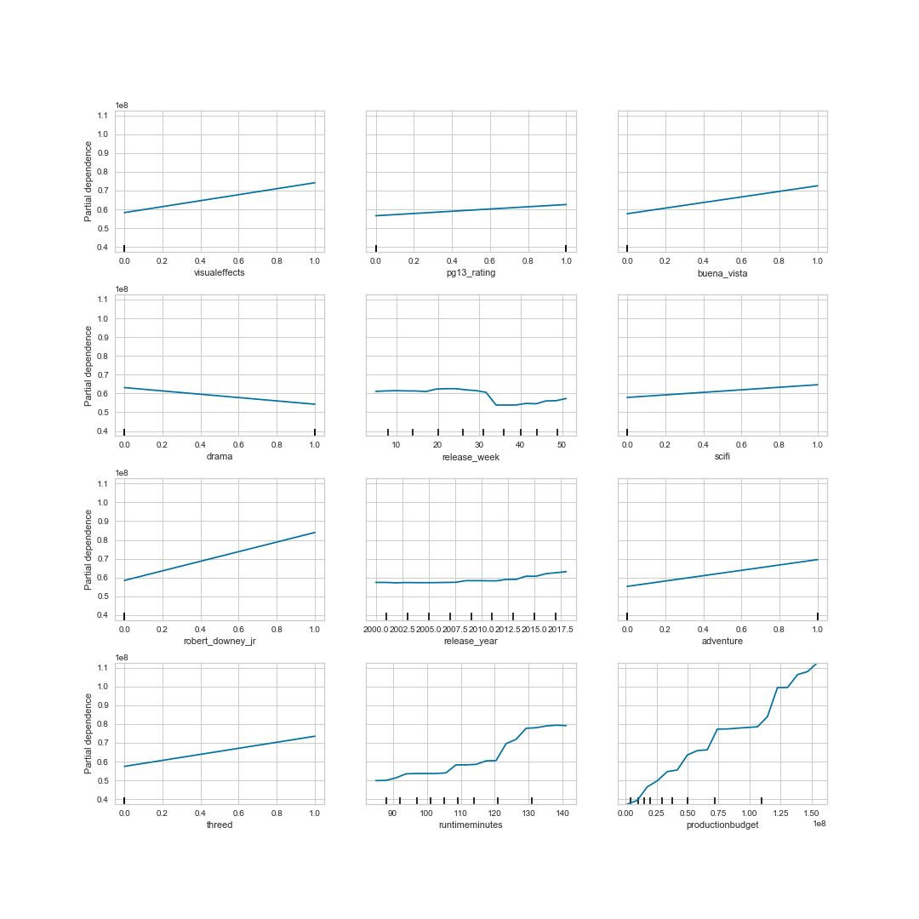
Partial Dependence Plots

Slide 38
Industrialization

Slide 39
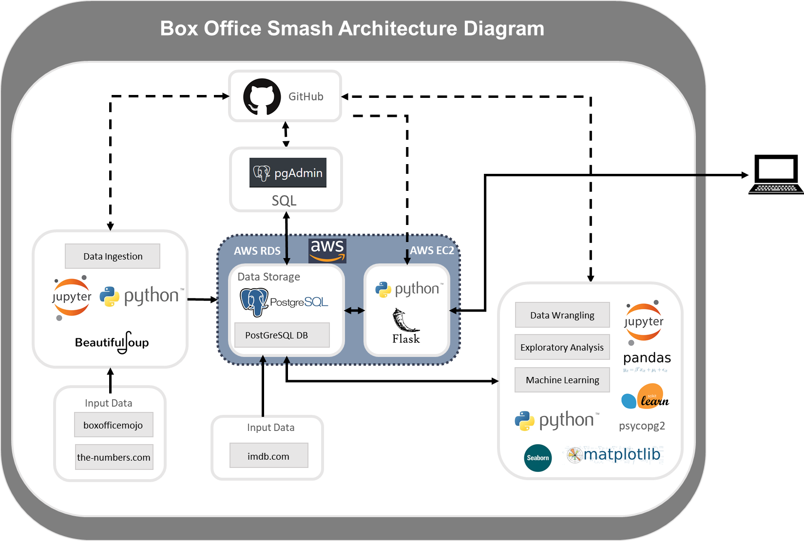
Architecture

